Slide 1
NCTU IEE 5046 高頻電路設計與實驗 PCB design with Pad Designer
Lecturer: Professor Yu-Jiu Wang
TA: 李道一michael@rfvlsi.ee.nctu.edu.tw
Document coauthor: Jon-Jin Chen

Slide 2
Related EDA tools
Pad Designer

Slide 3
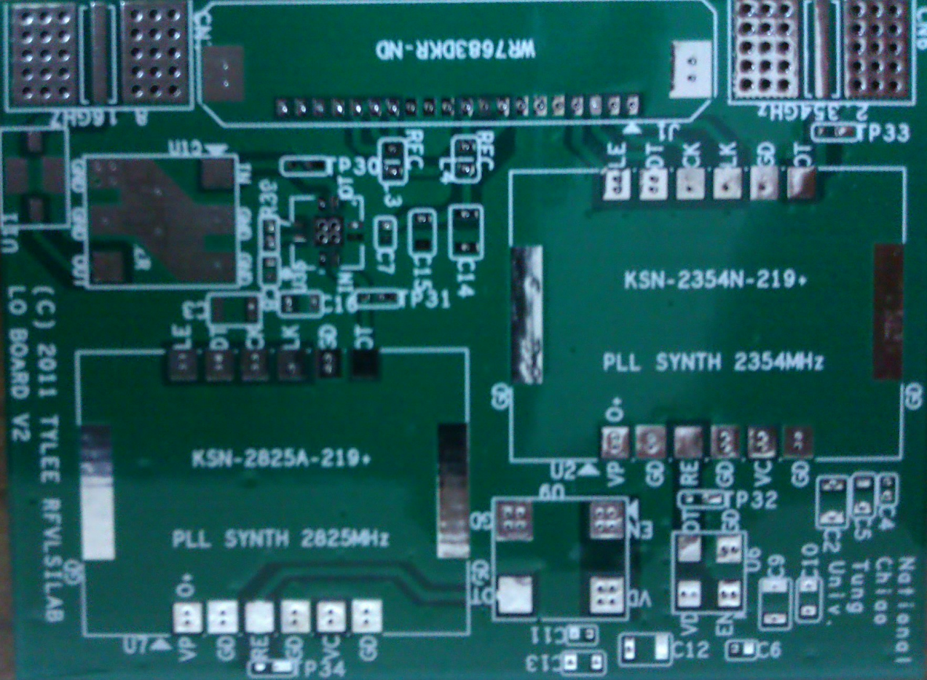
PCB basics
Solder mask
Dark Green
Etch layer
i.e. Conductors
Drill holes
Look closer to the pads
Silk Screen
White characters and lines

Slide 4
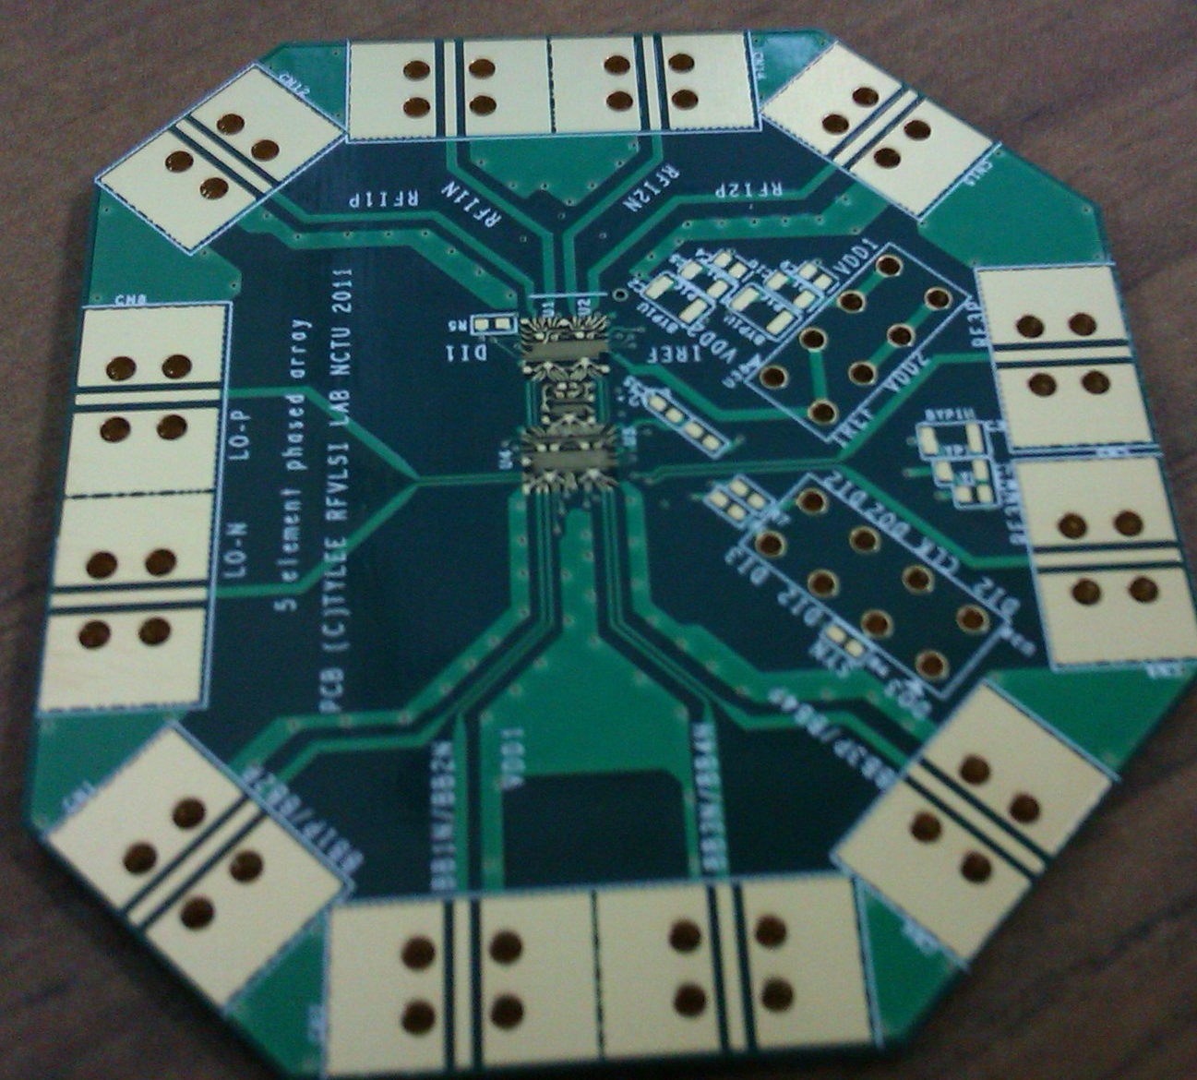
High Frequency PCB
Impedance control
GND plane
Cable to board transition
EMI/EMC

Slide 5
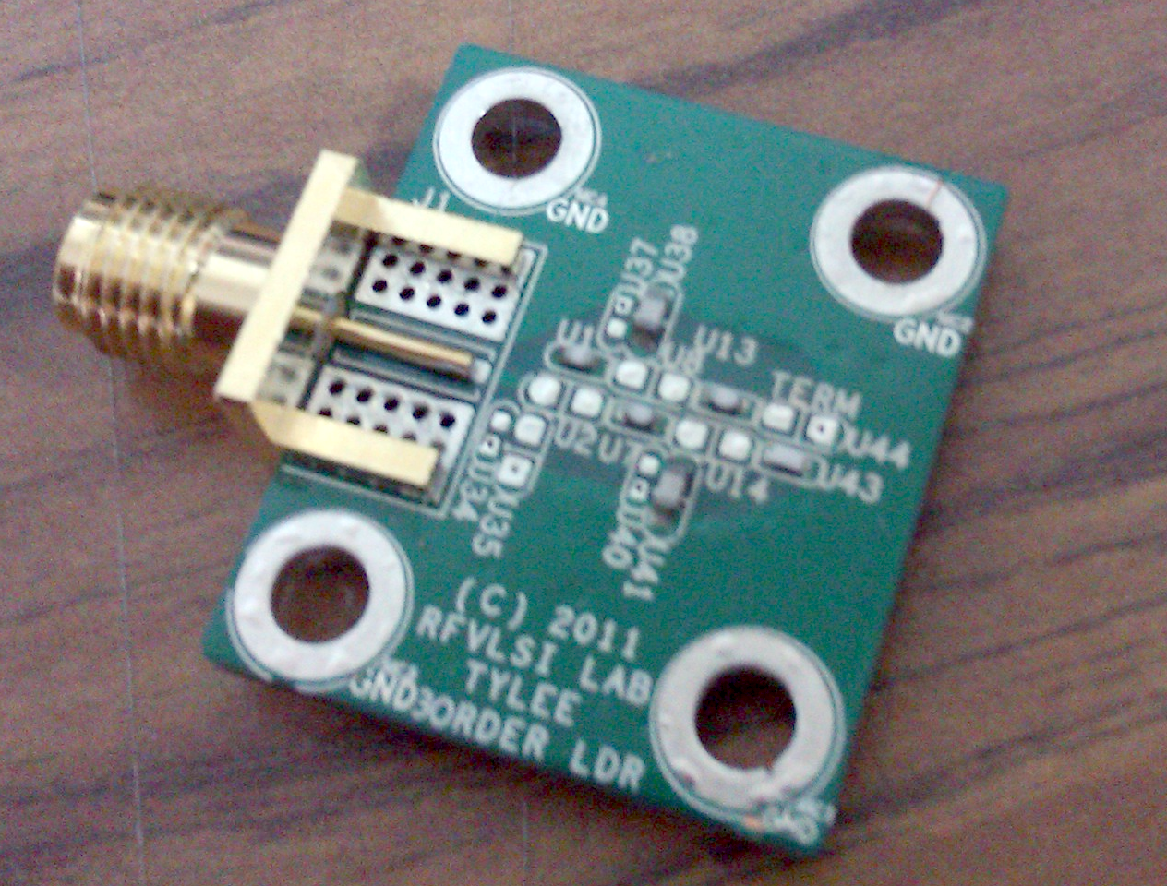
SMT Soldering
Solder
Solder paste
Solder iron

Slide 6
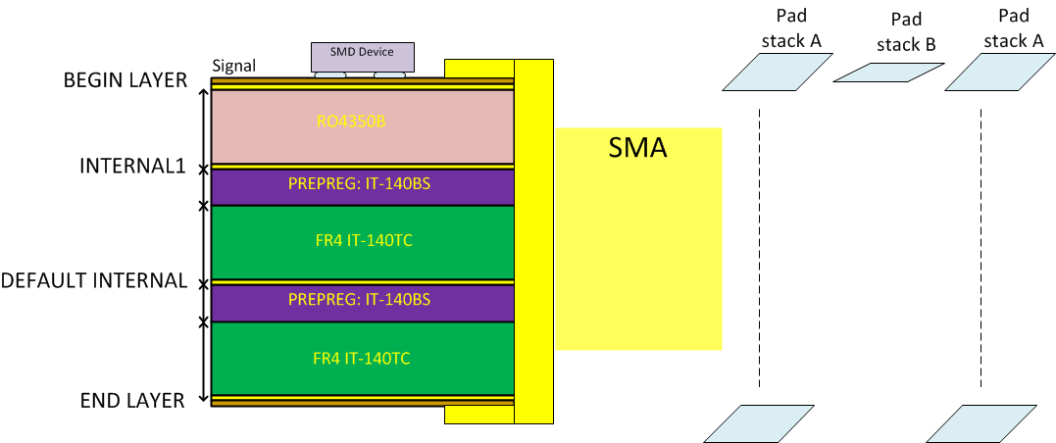
Pad-Stack (4 Layer Stack Up)

Slide 7
Definitions
Copper pad
Antipad
Thermal Relief
Soldermask
Drill
Plated: Conductive
Non-Plated: Isolated

Slide 8
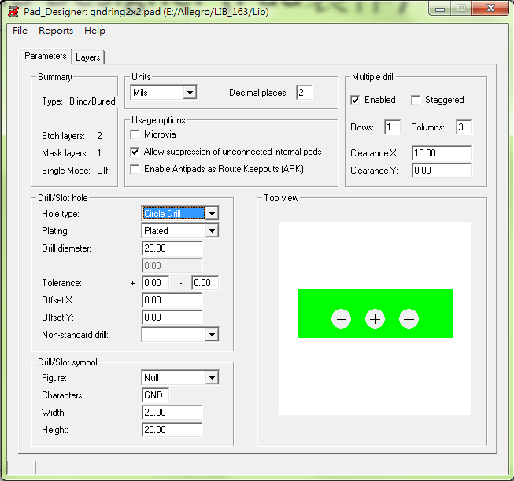
Create a Pad in Pad Designer “Parameters” Tab
Start Pad Designer
Switch to “Parameters” tab
Set units to “mils” with decimal places 2
Decide whether to place drill holes on pad, if no drills needed, set drill diameter to 0.
Do not use rectangle shaped drill holes in your project
Drill/Slot symbol: optional
Define multiple drill on the upper right pane, check “enabled” to enable; Specify clearances if needed.

Slide 9
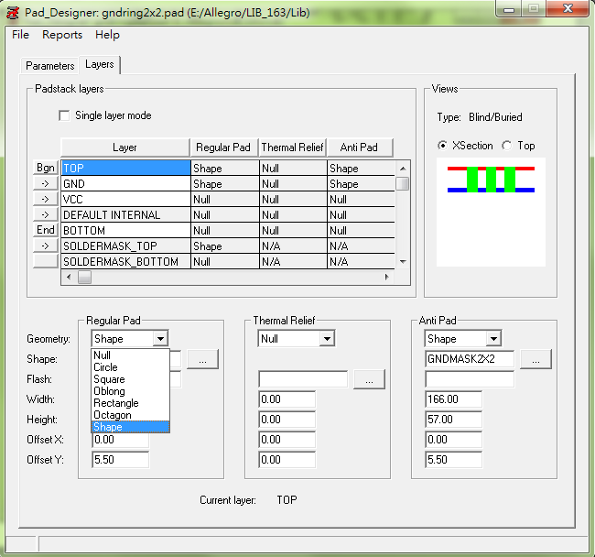
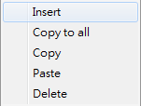
Create a Pad in Pad Designer “Layers” Tab
For SMD: Check “Single layer mode”
Right click on “Bgn” to insert layers
Select regular pad shape and specify size
Antipads
for PCB with internal conducting layers, define antipads
should be lager than regular pad , 6 mils around
Solder-masks should also be larger than regular pad
Save your *.pad to the specified “PADPATH” in Allegro

Slide 10
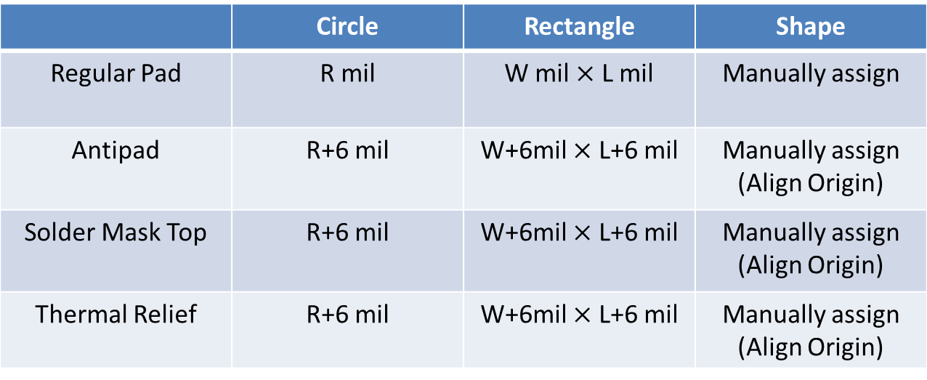
Create antipad / soldermask for a padstack
Generally, antipad and soldermask encloses regular pad by 3 mil (Depends on the min. etching gap of PCB process)
 | Circle | Rectangle | Shape
Regular Pad | R mil | W mil $×$ L mil | Manually assign
Antipad | R+6 mil | W+6mil $×$ L+6 mil | Manually assign (Align Origin)
Solder Mask Top | R+6 mil | W+6mil $×$ L+6 mil | Manually assign (Align Origin)
Thermal Relief | R+6 mil | W+6mil $×$ L+6 mil | Manually assign (Align Origin)

Slide 11
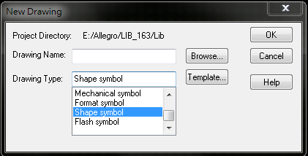

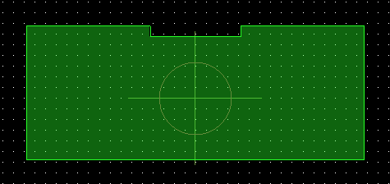
Special Shaped Pads New “Shape symbol” in PCB Editor
File -> New
Create a shape symbol
此時只有Etch可以用
用上列工具列畫出想要的圖形後
Shape -> Merge Shapes可以把圖合再一起，才不會有DRC Error
畫完後直接在外面加一層3mil的框用來做Pad的Soldermask (要另存)這樣他們就會對齊
Default drill hole location is the origin

Slide 12
SMA Connector Padstack
Bo-Jiang(帛江)
7867LS

Slide 13
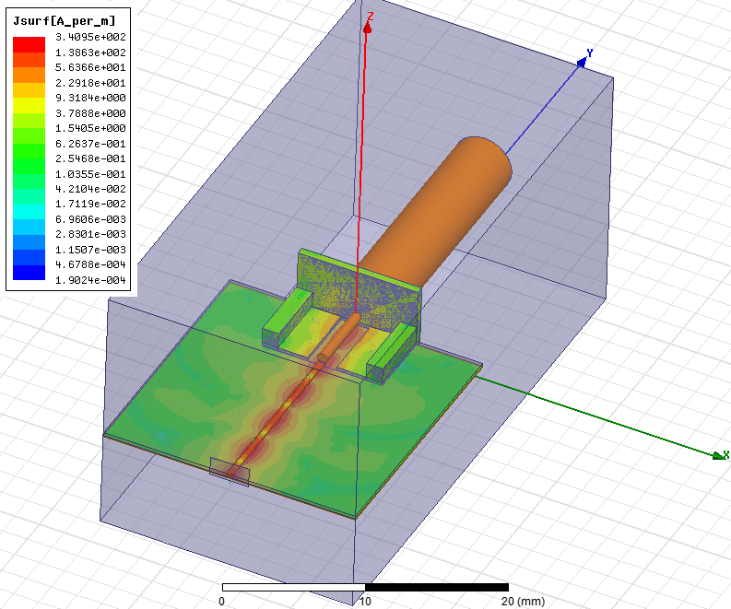
Surface Current Density Plot @ Radio Frequency

Slide 14
Assignment
pad-stack for SOLT
short.dra
open.dra
load.dra
through.dra
Due: Apr. 16th 2013
Group-based demo (in class)
Submit files to E3

